Slide 2
ASP.NET Core Health Checks
Juergen Gutsch
@sharpcms | https://asp.net-hacker.rocks

Slide 3
About me
Microsoft MVP for Developer Technologies
Blogging on https://asp.net-hacker.rocks
Writing for .NET Magazines
Leading a .NET User Group in Basel
Speaking at community events and meetups
Streaming on Twitch
https://www.twitch.tv/juergengutsch
Engineering Software at the YOO in Basel (CH)
https://yoo.digital

Slide 4
Agenda
About the ASP.NET Core Health Checks
Implementing and using Health Checks
Community and more Health Checks
Enhanced Scenario
All sources are available on GitHub
https://github.com/JuergenGutsch/dotnetconf2019

Slide 5
About the Health Checks

Slide 6
What are the ASP.NET Health Checks?
Check the health of application subsystems
Handle the health of a subsystem
Provide an endpoint to show information about the health of the current application
Namespace
Microsoft.Extensions.Diagnostics.HealthChecks

Slide 7
A little bit of history
Development started at in 2016
Damien Bowden, Glen Condron and Andrew Nurse and me at the ASP.NET hackathon during the MVP Summit 2016
Moved through various repositories until it makes it into the product
Introduced with ASP.NET Core 2.2

Slide 8
What you can do with Health Checks
Monitoring the health of parts of your application
…of your applications sub-systems
Databases
APIs
Services
…of the environment of your application
Memory
Performance
Drive space
Providing the health state of your application

Slide 9
Why should I use the Health Checks
Handle unhealthy states of your application, your sub-systems or your environments
Keep your app partially running in case of an unhealthy state
Tell your users about the unhealthy state
Switch to alternative sub-systems in case of an unhealthy state

Slide 10
Implementing and using Health Checks

Slide 11
Implementing and using Health Checks
Creating a new ASP.NET Core MVC Application using the .NET CLI
dotnet new mvc –n HealthChecksDemo –o HealthChecksDemo
Configuring Health Checks
Implementing Health Checks
Using the Health Check Service

Slide 12
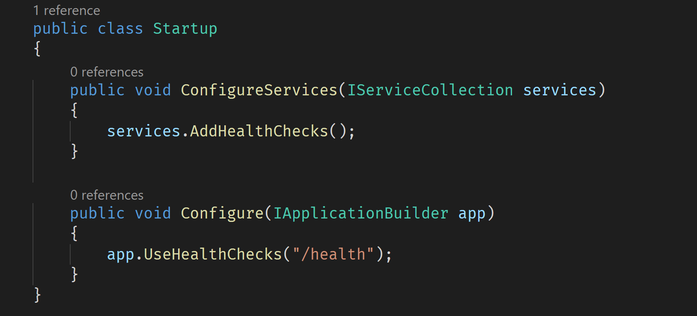
Basic configuration

Slide 13
Basic Health Checks demo

Slide 14
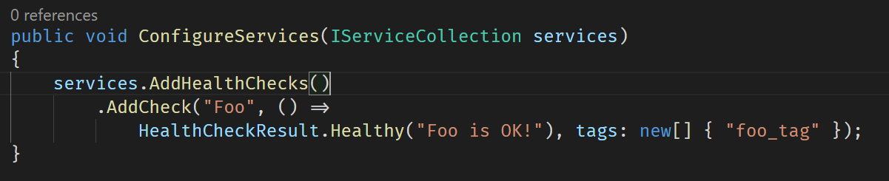
Simple delegate based Health Check

Slide 15
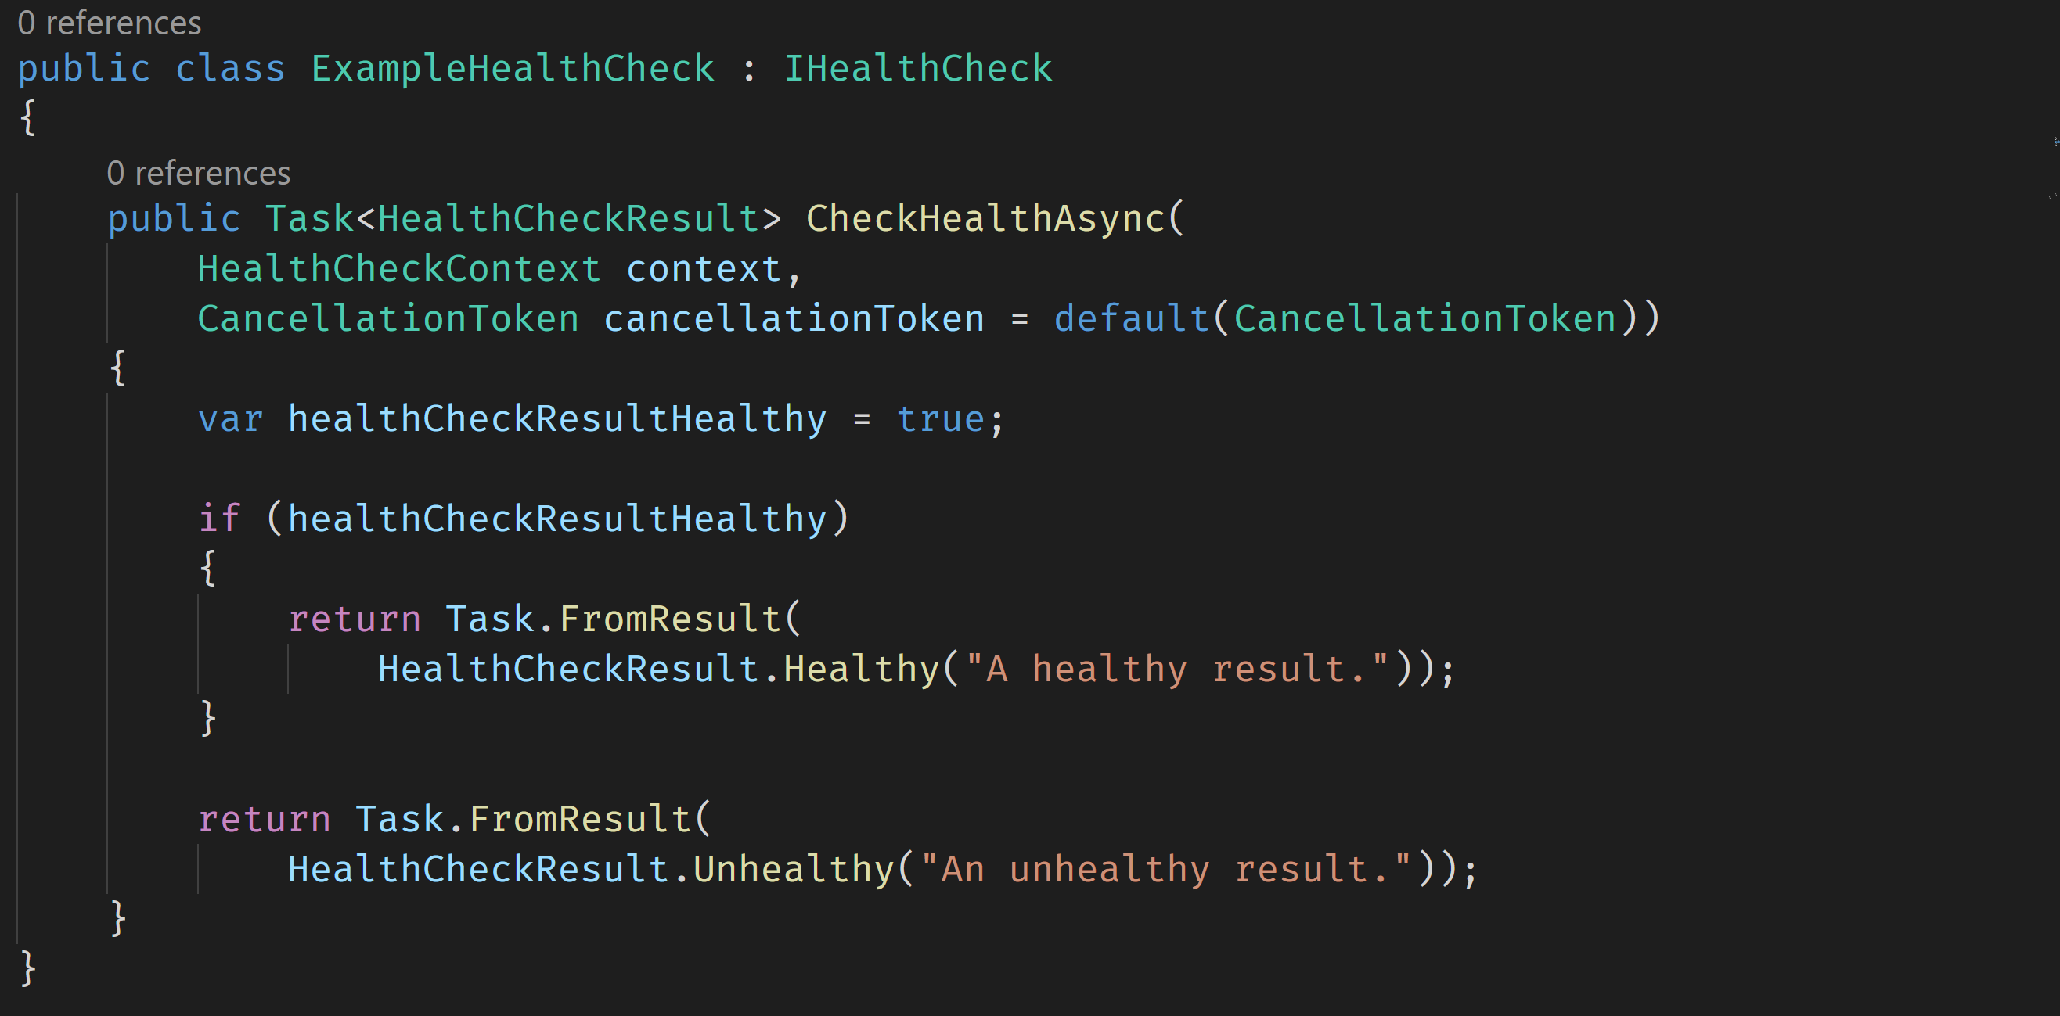
Class based Health Check

Slide 16
Creating Health Checks demo

Slide 17
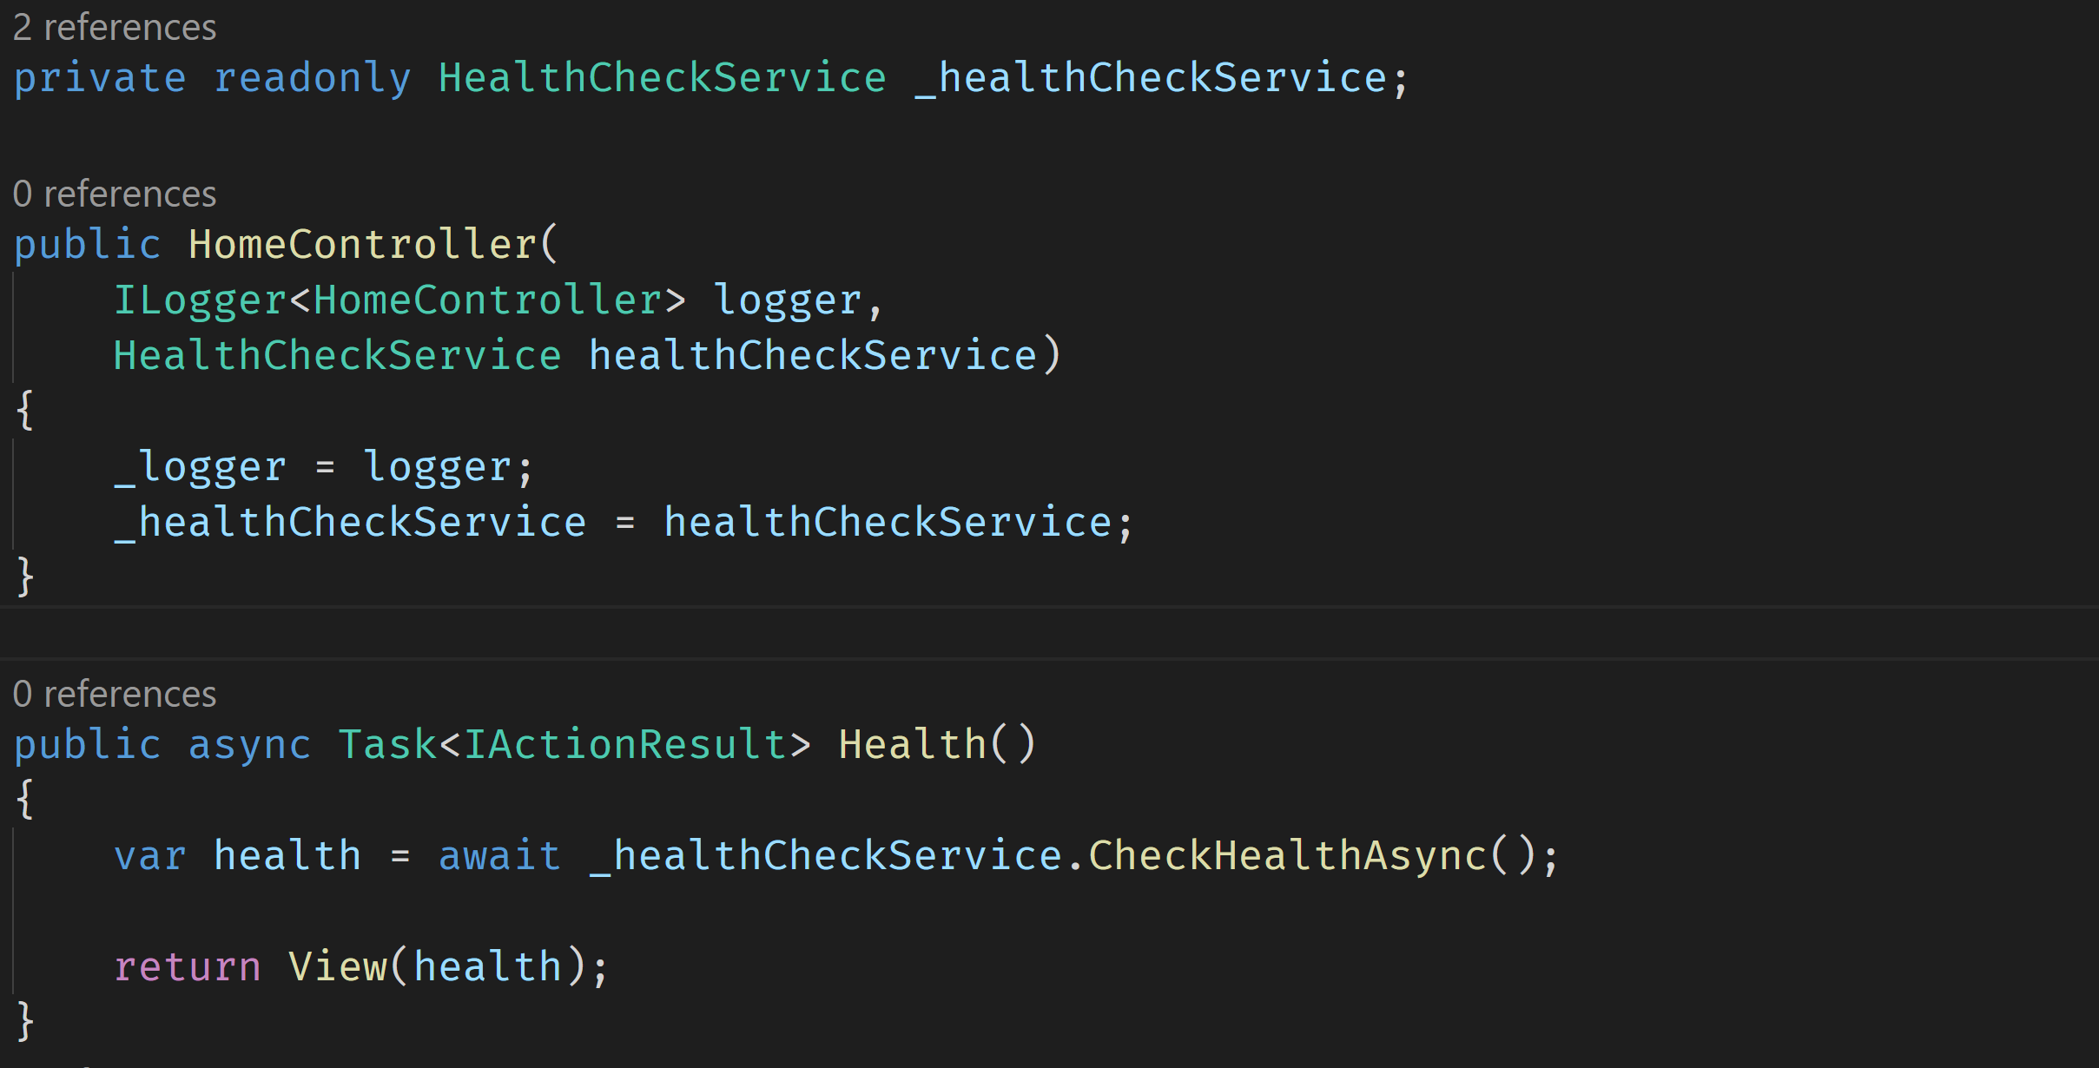
Using the Health Check Service

Slide 18
Using Health Checks demo

Slide 19
Community and Health Checks

Slide 20
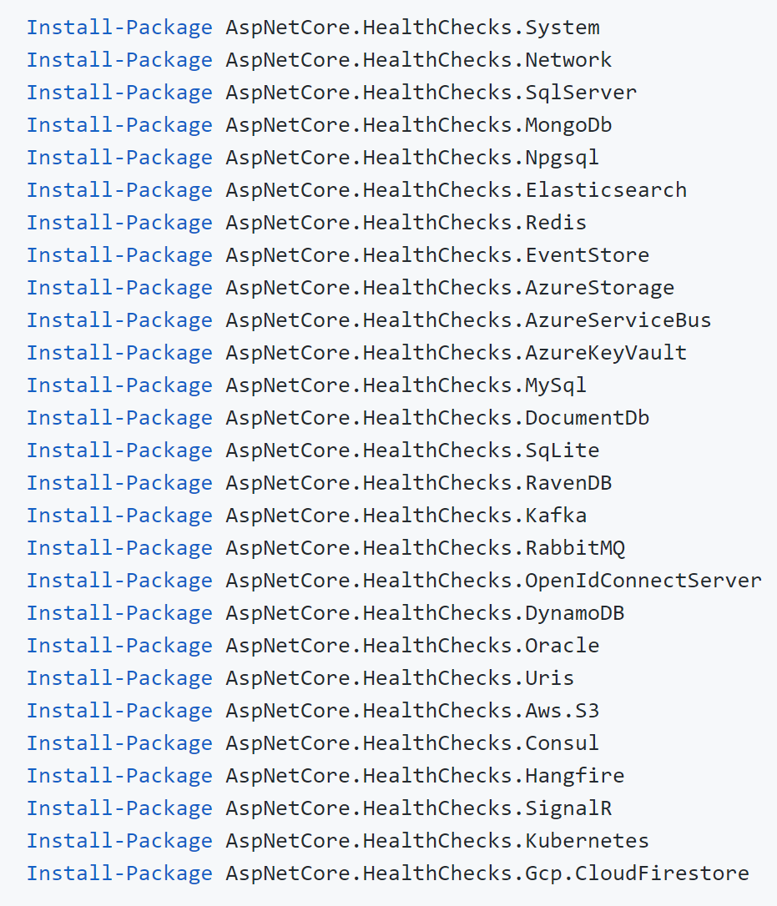
Health Checks made by the Community
Enterprise HealthChecks for ASP.NET Core Diagnostics Package
https://github.com/Xabaril/AspNetCore.Diagnostics.HealthChecks
“This project is a BeatPulse liveness and UI port to new Microsoft Health Checks feature included on ASP.NET Core from 2.2 version.”

Slide 21
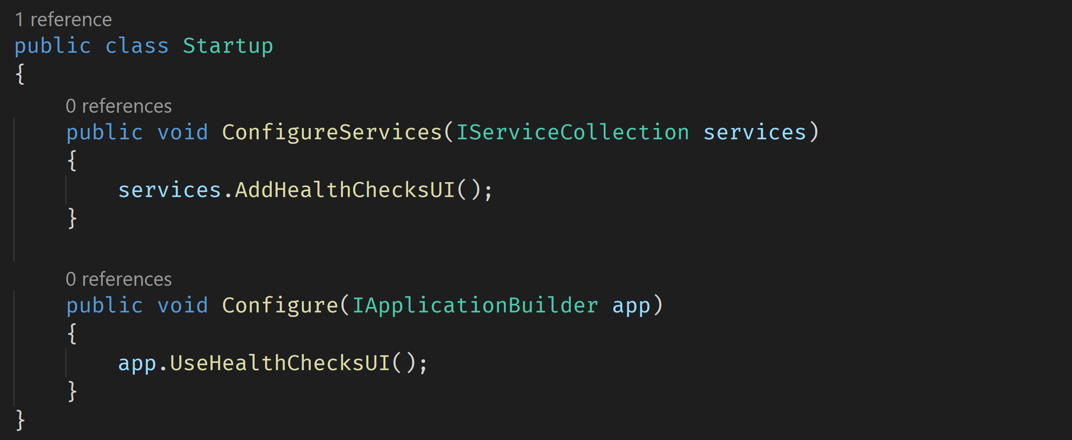
Health Check UI
AspNetCore.HealthChecks.UI

Slide 22
Enhanced scenario

Slide 23
Enhanced scenario
Weather statistics application
Four different weather stations
Station 1: Bremerton
Station 2: Cedar Lake
Station 3: Kent
Station 4: Monroe
One health monitoring app
(Maybe later a weather data visualization app)
All running in Docker containers

Slide 24
Enhanced demo

Slide 25
Thank you!
Juergen Gutsch
@sharpcms | https://asp.net-hacker.rocks

Slide 26

My next book:
Customizing
ASP.NET Core 3.0
Available on Leanpub soon:
https://leanpub.com/customizing-aspnetcore

